Slide 1


Exploring
World Happiness
30 March 2026

Slide 2
Table of Contents
Introduction
Data Cleansing
01
Overview of the World Happiness dataset, including the source, relevancy, and reliability. Defines the project’s aims and objectives.
02
Describes the data preparation processes, focusing on key transformations, notably a Happiness Index for analysis.
Data Analysis
Conclusion
03
Explanation of analytical methods and tools used to explore the dataset. Highlights key patterns, trends, and anomalies to form insights.
04
Final evaluation, presenting actionable insights, limitations, and future considerations.

Slide 3

01.
Introduction
Presented By | ***

Slide 4
Why We Chose this Topic?
World Happiness
01
02
03
04
05
Relevant to Everyone
Meaningful Data
Multiple Analytical Directions
Mixed Data Types
Existing Studies Support

Slide 5
Why this Dataset?
Public Dataset:
Credible Source
01
From: World Bank DataBank Dataset: Happiness Data
Meta-data for Each Variable:
Detailed
02
Definition & Methodology.
Relevance to wellbeing.
Limitations & Exceptions
Sources of country-level breakdown.
Suitable For:
Comparison
03
Cross-country.
Cross-continent.
Time-series.
04
Acknowledges:
Limitations
Cultural bias.
Missing countries.
Subjectivity.

Slide 6
Aims of the Project?
Build a data-driven happiness indicator using national, economic, social, and health data.
Compare wellbeing across countries, continents, and years.
01
02

Slide 7
Objectives
Measure
Interpret
01
Develop a weighted formula to calculate a happiness score.
04
Analyse patterns and explain differences between countries.
02
Normalise
05
Present
Standardise variables to reduce scale bias.
Visualise results clearly (e.g. gauges, charts).
03
Parsing
06
Forecast
Implement a ‘Happiness Index’ column in Excel.
Predict happiness levels for the next 5 years.

Slide 8

02.
Data Cleansing
Presented By | Jimmy

Slide 9
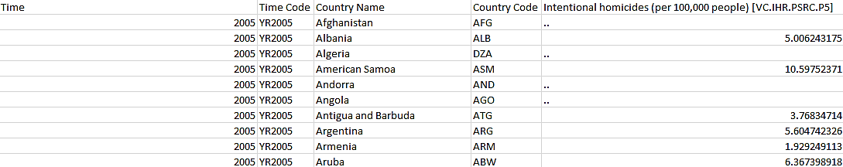
Snapshot of the Raw Data
From Insights to Action
01
Sense Checks
03
Validating the data accuracy and consistency, to ensure that the data is standardized and logical.
Redundancy
02
Data Parsing
Removing irrelevant or redundant data to improve clarity and efficiency.
Enhancing the dataset by deriving additional fields to support meaningful analysis.

Slide 10
Eliminating Noise
FIRST STAGE
SECOND STAGE
THIRD STAGE
Field Reduction
Deduplication
Substituting Values
The exclusion of non-essential columns for improved clarity and focus on the analysis. These include:
Time Code
Country Code
Removal of repeating records to ensure that the observed values are unique and not overrepresented. Duplicates Found:
4
Replacing missing values with placeholders that maintain the dataset completeness. Replaced Values:
“..”
To
BLANK

Slide 11
Ensuring Data Integrity
Text Consistency
Outlier Detection
Ensuring text values maintain the same structure and are correct.
Includes:
Spelling checks.
Removing identifiers.
Text formatting.
Identifying unexpected extreme values, that may indicate errors or usual observations that could affect analysis.
Determined Fields:
GDP fields.
Standardise Values
Value Validation
Applying uniform naming conventions across fields and records.
Includes:
Metric for fields.
Uniform currency.
Verifying whether values fall within expected ranges and following proper formatting.
Includes:
Type checks.
Formatting checks.
Range checks.

Slide 12

Data Enrichment
Deriving a Measure for Happiness
Life Evaluation ≈
β0
+ β1 · log(GDP per capita)
+ β2 · Social Support
+ β3 · Healthy Life Expectancy
+ β4 · Freedom to Make Life Choices
+ β5 · Generosity
+ β6 · Perceptions of Corruption
Happiness Index ≈
0.25 · GDP
+ 0.20 · LifeExpectancy
+ 0.15 · Education
+ 0.10 · GovEducationSpending
- 0.10 · Unemployment
- 0.05 · YouthUnemployment
- 0.05 · Homicide
- 0.05 · Inflation
- 0.03 · Gini
- 0.02 · Mortality

Slide 13
Data Enrichment
Happiness Index
Continents
Rankings
A calculated measure adapted from the World Happiness Report’s Life Evaluation. Estimates a country’s overall happiness.
Categoric label grouping countries by continent. Enables cross-continent comparisons and aggregation.
Ordinal values assigned by each country’s average Happiness Index. Allows for comparisons between countries based on relative position.

Slide 14
03.
Data Analysis
Presented By | *** & ***

Slide 15
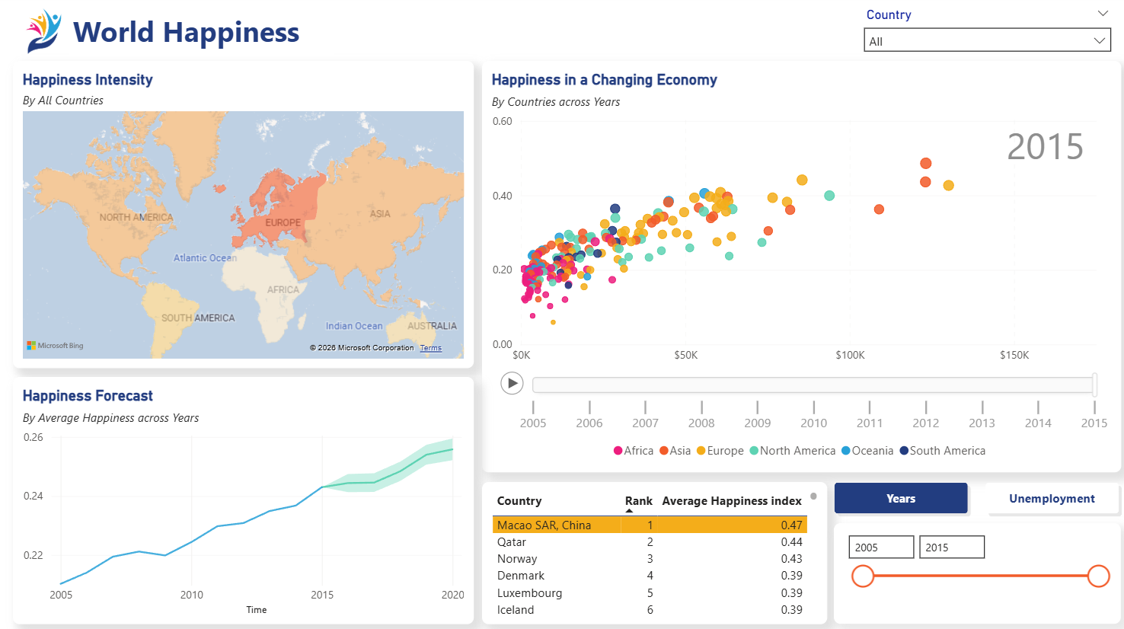

Slide 16
04.
Conclusion
Presented By | ***

Slide 17
Were they Met?
Yes
Interactive Visuals
Predictions
Showing GDP vs. Happiness relationships
A forward-looking happiness forecast.
Aims & Objectives
Comparative Insights
Time-series Analysis
Across regions and countries.
Using animated scatter graphs.

Slide 18
Limitations
01
02
03
04
Data Complexity
Gaps in Data
Forecast Uncertainty
Visual Constraints
Happiness is multi-dimensional and cannot be fully explained by GDP alone.
Data availability and consistency may vary across countries and years.
The forecast is based on historical trends and may not account for unexpected global events.
Some visuals (e.g. map) were limited due to configuration restraints.

Slide 19
Future Considerations
Advanced Forecasting
Refresh Data
Improve forecasting models by using more advanced techniques.
Include more recent data for improve relevance.
01
02
03
04
Broaden Variables
Interactive Filters
Incorporate additional variables into our analysis such as health, education, and social support.
Add user-driven filters for deeper drill-down analysis.

Slide 20
Credits
Slideshow Materials: Yadira
Logo Icon: Designmantic.com
Dataset: World Bank DataBank
Team Members:
***
***
Jimmy
***
***
Honorary Members:
***
ChatGPT

Slide 21
THANK
YOU!
Do you have any questions?

